Slide 1
Domain ML
Technology: Python
Explainable Data Driven Digital Twins for Predicting Battery States in Electric Vehicles

Slide 2
INDEX
Project Description
Problem Statement
Objective
Scope
Literature Survey
Significant
Proposed System
Architecture
UML
Resource Requirements
Research Gap analysis
Implementation
1. Data Description
2. EDA Explanation
3. Preprocessing steps
Model Implementation
1. Algorithm Definition
2. working Process
3. Results from Algorithm
Performance comparison
Output Screen
Future Scope
Conclusion
References

Slide 3
Project Description
As the automotive industry rapidly advances towards electric vehicles (EVs), accurately predicting battery states is crucial for optimizing performance, safety, and longevity. This project presents a novel approach using Explainable Data-Driven Digital Twins to predict battery states in electric vehicles. The methodology integrates various advanced machine learning algorithms, including Deep Neural Networks (DNN), Long Short-Term Memory (LSTM) networks, Convolutional Neural Networks (CNN), Support Vector Regression (SVR), Support Vector Machines (SVM), Feedforward Neural Networks (FNN), Radial Basis Function networks (RBF), Random Forests (RF), and Extreme Gradient Boosting (XGBoost).The primary objective of this study is to enhance the predictability of battery states by leveraging these diverse algorithms to build a comprehensive digital twin model. The model aims to provide accurate predictions of key battery parameters such as state of charge (SOC) and state of health (SOH) under various operational conditions.

Slide 4
Problem Statement:
The growing adoption of electric vehicles (EVs) has placed significant demand on the accurate prediction of battery states, including state of charge (SOC) and state of health (SOH). Traditional methods for predicting these states often struggle with the complex, dynamic nature of battery systems, leading to suboptimal performance in battery management systems. Inaccurate predictions can result in reduced battery lifespan, unexpected failures, and inefficient energy utilization, which in turn affects the overall reliability and user acceptance of EVs. The problem is further compounded by the lack of interpretability in many machine learning models, making it difficult to understand the factors influencing battery states. This project aims to address these challenges by developing a comprehensive digital twin model using explainable data-driven approaches to accurately predict battery states and provide insights into the underlying factors affecting battery performance.

Slide 5
Objective of the Project:
The primary objective of this project is to develop an explainable data-driven digital twin model that accurately predicts key battery states, specifically state of charge (SOC) and state of health (SOH), in electric vehicles (EVs). The project aims to integrate a variety of advanced machine learning algorithms, including Deep Neural Networks (DNN), Long Short-Term Memory (LSTM) networks, Convolutional Neural Networks (CNN), Support Vector Regression (SVR), and others, to build a robust and reliable prediction model. In addition to achieving high prediction accuracy, the project also seeks to incorporate explainable AI techniques to provide transparency and understanding of the model’s predictions. By achieving these objectives, the project aims to enhance battery management systems, ultimately contributing to the improved performance, safety, and longevity of batteries in EVs.

Slide 6
Scope:
The scope of this project encompasses the development, implementation, and validation of an explainable data-driven digital twin model for predicting battery states in electric vehicles (EVs). The project will involve the integration of multiple machine learning algorithms, including Deep Neural Networks (DNN), Long Short-Term Memory (LSTM) networks, Convolutional Neural Networks (CNN), and others, to create a comprehensive and robust model. The model will focus on predicting crucial battery states, such as state of charge (SOC) and state of health (SOH), under various operational conditions. Additionally, the project will explore the use of explainable AI techniques to interpret the model’s predictions, providing insights into the factors affecting battery performance. The final outcome will be a validated digital twin model that can be applied in real-world EV battery management systems, with the potential for further refinement and adaptation to different battery technologies.

Slide 7
LITERATURE SURVEY
Author | Year | Title | Outcomes
Zhang, X., Li, Y., & Chen, H.). | 2020 | Explainable Artificial Intelligence (XAI) for Battery State Prediction in Electric Vehicles | This paper discusses the integration of Explainable AI techniques into battery state prediction models for electric vehicles
Wang, Z., & Liu, J. | 2019 | Machine Learning-Based Battery State Estimation: A Survey of Methods and Applications | This survey paper provides an extensive review of machine learning techniques applied to battery state estimation, with a focus on electric vehicles
3. Li, W., & Zhao, Y. . | 2021 | Data-Driven Digital Twins for Predicting Battery Degradation in Electric Vehicles | This paper presents a data-driven approach to developing digital twins for predicting battery degradation in electric vehicles

Slide 8
Author | Year | Title | Outcomes
Smith, A., & Jones, R. | 2022 | A Comprehensive Review of Battery Management Systems Using Artificial Intelligence Techniques | This comprehensive review covers the latest advancements in battery management systems (BMS) that leverage artificial intelligence techniques
5. Kumar, R., & Gupta, S | 2021 | Explainable Machine Learning for Predicting Battery Life in Electric Vehicles | This study focuses on the application of explainable machine learning techniques for predicting battery life in electric vehicles

Slide 9
Significant
The significance of this project lies in its innovative approach to improving battery state predictions for electric vehicles (EVs) through Explainable Data-Driven Digital Twins. By integrating a range of advanced machine learning algorithms, the project aims to optimize the accuracy of predicting critical battery parameters such as state of charge (SOC) and state of health (SOH). This enhancement in prediction capabilities is vital for maximizing battery performance, safety, and longevity in EVs, addressing a key challenge in the automotive industry's transition to electric mobility.

Slide 10
Proposed System:
The proposed system aims to enhance battery state prediction in electric vehicles through the development of Explainable Data-Driven Digital Twins. This system leverages a suite of advanced machine learning algorithms, including Deep Neural Networks (DNN), Long Short-Term Memory (LSTM) networks, Convolutional Neural Networks (CNN), Support Vector Regression (SVR), Support Vector Machines (SVM), Feedforward Neural Networks (FNN), Radial Basis Function networks (RBF), Random Forests (RF), and Extreme Gradient Boosting (XGBoost). By integrating these diverse algorithms, the system is designed to deliver highly accurate and reliable predictions of critical battery parameters such as state of charge (SOC) and state of health (SOH). Additionally, the system incorporates explainability features, providing transparency into the factors influencing battery performance and enhancing user trust. This approach not only improves prediction accuracy but also addresses the limitations of existing systems by offering adaptability, comprehensive data integration, and detailed insights into battery behavior.

Slide 11
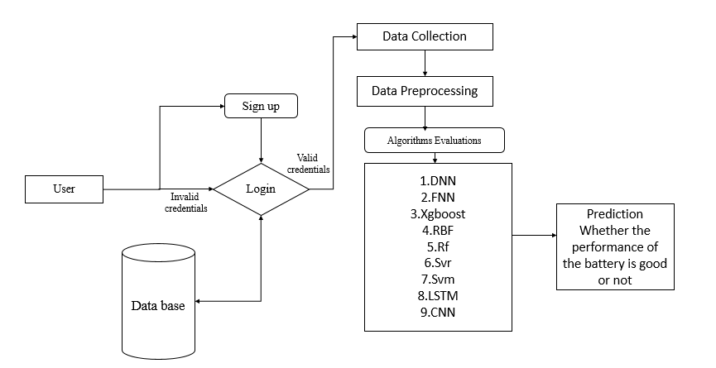
Architecture:

Slide 12
Resource Requirements
.
01
Hardware
(Processor: I5/Intel Processor, RAM: 8GB (min), Hard Disk: 128 GB, Key Board: Standard Windows Keyboard, Mouse: Two or Three Button Mouse)
Resources
02
Software
(Operating System: Windows 10, Programming Language: Python 3.10.8, IDE: VS Code)
03
Packages/Libraries
(Streamlit, Sklearn, Transformers, Tensorflow, Pandas, Seaborn, Speech Recognition

Slide 13
UML DIAGRAMS
UML stands for Unified Modelling Language. UML is a standardized general-purpose modelling language in the field of object-oriented software engineering. The standard is managed, and was created by, the Object Management Group.
The goal is for UML to become a common language for creating models of object-oriented computer software. In its current form UML is comprised of two major components: a Meta-model and a notation. In the future, some form of method or process may also be added to; or associated with, UML.
The Unified Modelling Language is a standard language for specifying, Visualization, Constructing and documenting the artefacts of software system, as well as for business modelling and other non-software systems. The UML represents a collection of best engineering practices that have proven successful in the modelling of large and complex systems.
The UML is a very important part of developing objects-oriented software and the software development process. The UML uses mostly graphical notations to express the design of software projects.

Slide 14
GOALS:
The Primary goals in the design of the UML are as follows:
Provide users a ready-to-use, expressive visual modelling Language so that they can develop and exchange meaningful models.
Provide extendibility and specialization mechanisms to extend the core concepts.
Be independent of particular programming languages and development process.
Provide a formal basis for understanding the modelling language.
Encourage the growth of OO tools market.
Support higher level development concepts such as collaborations, frameworks, patterns and components.
Integrate best practices.

Slide 15
USE CASE DIAGRAM
A use case diagram in the Unified Modeling Language (UML) is a type of behavioral diagram defined by and created from a Use-case analysis.
Its purpose is to present a graphical overview of the functionality provided by a system in terms of actors, their goals (represented as use cases), and any dependencies between those use cases.
The main purpose of a use case diagram is to show what system functions are performed for which actor. Roles of the actors in the system can be depicted.

Slide 16
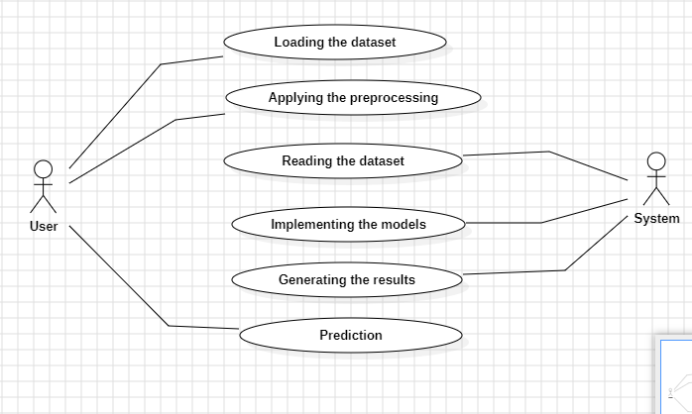

Slide 17
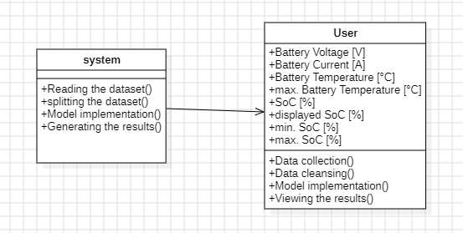
CLASS DIAGRAM
In software engineering, a class diagram in the Unified Modeling Language (UML) is a type of static structure diagram that describes the structure of a system by showing the system's classes, their attributes, operations (or methods), and the relationships among the classes. It explains which class contains information

Slide 18
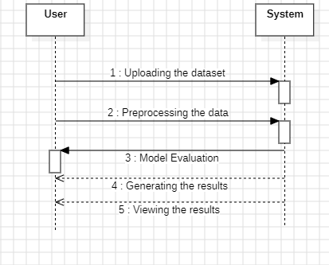
SEQUENCE DIAGRAM
A sequence diagram in Unified Modeling Language (UML) is a kind of interaction diagram that shows how processes operate with one another and in what order.

Slide 19
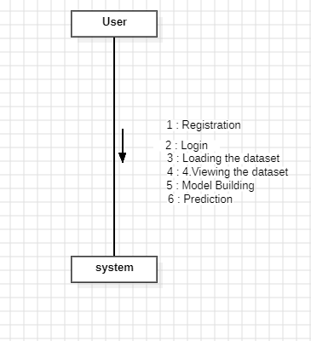
COLLABORATION DIAGRAM:
In collaboration diagram the method call sequence is indicated by some numbering technique as shown below. The number indicates how the methods are called one after another. We have taken the same order management system to describe the collaboration diagram. The method calls are similar to that of a sequence diagram. But the difference is that the sequence diagram does not describe the object organization whereas the collaboration diagram shows the object organization.

Slide 20

DEPLOYMENT DIAGRAM
Deployment diagram represents the deployment view of a system. It is related to the component diagram. Because the components are deployed using the deployment diagrams. A deployment diagram consists of nodes. Nodes are nothing but physical hardware’s used to deploy the application.

Slide 21
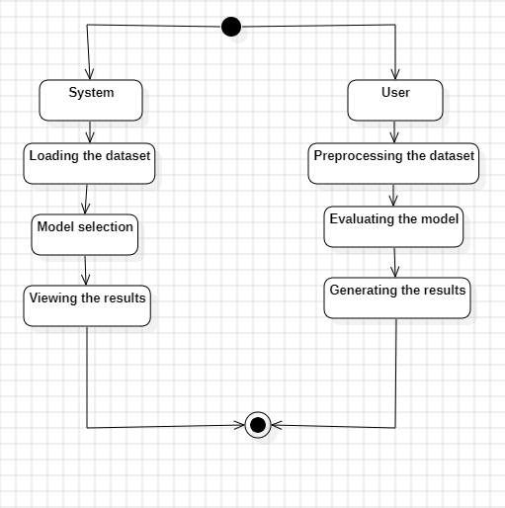
ACTIVITY DIAGRAM:
Activity diagrams are graphical representations of workflows of stepwise activities and actions with support for choice, iteration and concurrency. In the Unified Modelling Language, activity diagrams can be used to describe the business and operational step-by-step workflows of components in a system. An activity diagram shows the overall flow of control.

Slide 22
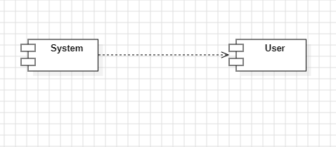
COMPONENT DIAGRAM:
A component diagram, also known as a UML component diagram, describes the organization and wiring of the physical components in a system. Component diagrams are often drawn to help model implementation details and double-check that every aspect of the system's required function is covered by planned development.

Slide 23
ER DIAGRAM:
An Entity–relationship model (ER model) describes the structure of a database with the help of a diagram, which is known as Entity Relationship Diagram (ER Diagram). An ER model is a design or blueprint of a database that can later be implemented as a database. The main components of E-R model are: entity set and relationship set.
An ER diagram shows the relationship among entity sets. An entity set is a group of similar entities and these entities can have attributes. In terms of DBMS, an entity is a table or attribute of a table in database, so by showing relationship among tables and their attributes, ER diagram shows the complete logical structure of a database. Let’s have a look at a simple ER diagram to understand this concept.

Slide 24
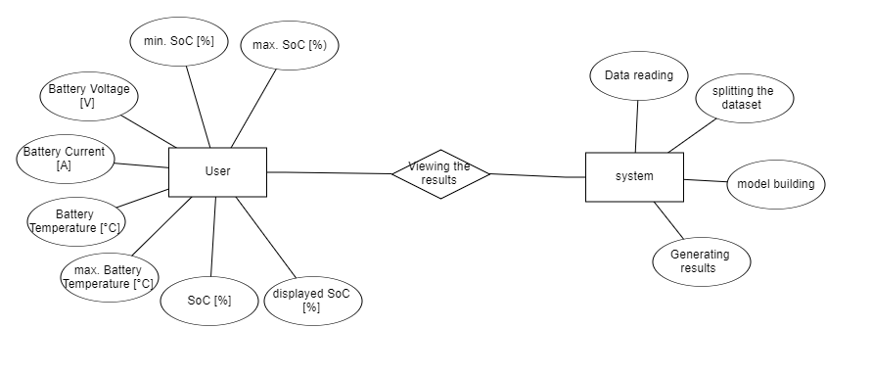
DFD DIAGRAM:
A Data Flow Diagram (DFD) is a traditional way to visualize the information flows within a system. A neat and clear DFD can depict a good amount of the system requirements graphically. It can be manual, automated, or a combination of both. It shows how information enters and leaves the system, what changes the information and where information is stored. The purpose of a DFD is to show the scope and boundaries of a system as a whole. It may be used as a communications tool between a systems analyst and any person who plays a part in the system that acts as the starting point for redesigning a system.

Slide 25
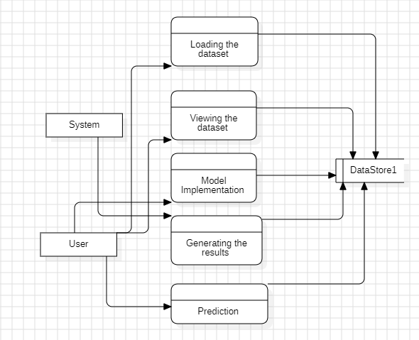

Slide 26
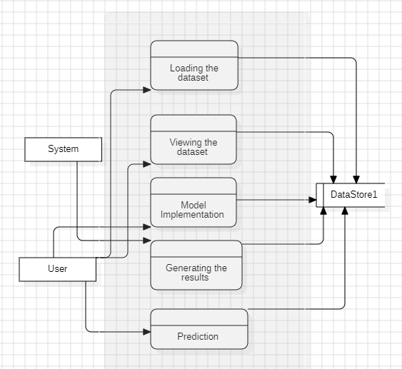

Slide 27
1. Limited Explainability in Current Battery Prediction Models
Gap: Existing machine learning models for battery state prediction often lack transparency, making it difficult to understand and trust their predictions.
Analysis: While advanced models like Deep Neural Networks (DNN) and Extreme Gradient Boosting (XGBoost) offer high accuracy, they are typically seen as "black boxes" with limited interpretability. This gap highlights the need for more explainable models that can provide insights into how predictions are made and why certain outcomes are generated.
2. Integration of Diverse Machine Learning Algorithms
Gap: Many current approaches focus on a single type of algorithm without exploring the benefits of combining multiple algorithms for improved performance.
Analysis: The project proposes integrating various machine learning algorithms, including DNN, LSTM, CNN, SVR, SVM, FNN, RBF, RF, and XGBoost. This diverse approach could address the limitations of individual models and enhance prediction accuracy, yet many existing studies do not leverage such comprehensive algorithmic integration.

Slide 28
3. Real-World Operational Conditions
Gap: Existing models may not account for the wide range of operational conditions that affect battery performance, such as varying temperatures, usage patterns, and driving conditions.
Analysis: By focusing on different operational scenarios, the proposed digital twin model aims to provide more accurate predictions of battery states under realistic conditions. This addresses a significant gap in current research, where models may be tested in idealized or controlled environments that do not fully reflect real-world usage.
4. Comprehensive Battery State Predictions
Gap: There is often a lack of comprehensive models that simultaneously predict multiple critical battery parameters, such as state of charge (SOC) and state of health (SOH).
Analysis: This project aims to build a model that accurately predicts both SOC and SOH. Most existing models might focus on predicting only one parameter or fail to provide integrated insights into multiple aspects of battery health, which is crucial for holistic battery management.

Slide 29
5. Application to Electric Vehicles
Gap: Research in battery state prediction may not always be specifically tailored to electric vehicles, which have unique requirements compared to other applications like consumer electronics.
Analysis: The project's focus on electric vehicles ensures that the developed digital twin model addresses the specific challenges and requirements of EV batteries, filling a niche that is often overlooked in broader battery research.

Slide 30
Implementation
Data Analysis
Model Implementation
01
Data Description
04
Algorithm Definition
02
EDA Explanation
05
Working Process
03
Preprocessing steps
06
Results from Algorithm

Slide 31
Data Description
Dataset: https://www.kaggle.com/code/trungnguyen0987/battery-soh-estimation/input?select=bat_charge%284%29.csv
1. Battery State of Health (SOH) Estimation Dataset
Source: Kaggle - Battery SOH Estimation
File: bat_charge(4).csv
Description: This dataset contains information related to the state of health (SOH) of batteries. It includes data collected from battery charge cycles, which can be used to estimate the degradation and overall health of the battery over time. Key variables likely include:
Charge Data: Measurements of battery charge levels during different cycles.
Cycle Information: Details about the battery's charge and discharge cycles.
Health Metrics: Indicators of battery performance and health, which are crucial for predicting battery life and reliability.

Slide 32
Dataset:https://www.kaggle.com/code/elianee/state-of-charge-soc-prediction-of-car-batteries/input?select=TripA01.csv
State of Charge (SOC) Prediction Dataset
Source: Kaggle - State of Charge (SOC) Prediction
File: TripA01.csv
Description: This dataset focuses on predicting the state of charge (SOC) of car batteries. It contains data related to the battery's performance during vehicle trips. Key variables likely include:
Time Series Data: Measurements recorded over time during different trips, including battery voltage, current, and other related parameters.
Trip Information: Details about each trip, such as duration, distance, and driving conditions, which influence battery SOC.
Charge Data: Information on how the battery's state of charge changes throughout each trip, which helps in predicting the remaining battery life and optimizing charging strategies.

Slide 33
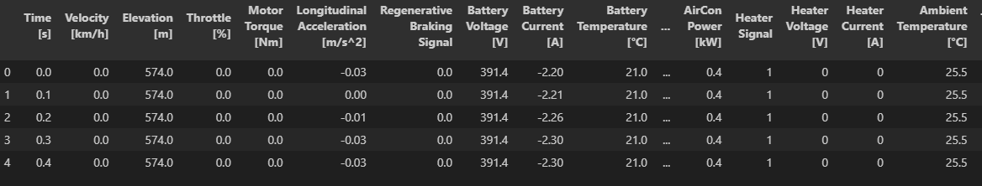
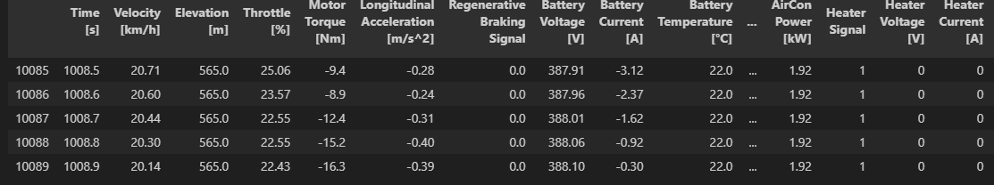
Exploratory Data Analysis
State of Charge (SOC) Prediction Dataset
This the top 5 rows of the dataset here we see the how was the dataset values
This the Bottom 5 rows of the dataset here we see the how was the dataset values

Slide 34

State of Charge (SOC) Prediction Dataset

Slide 35
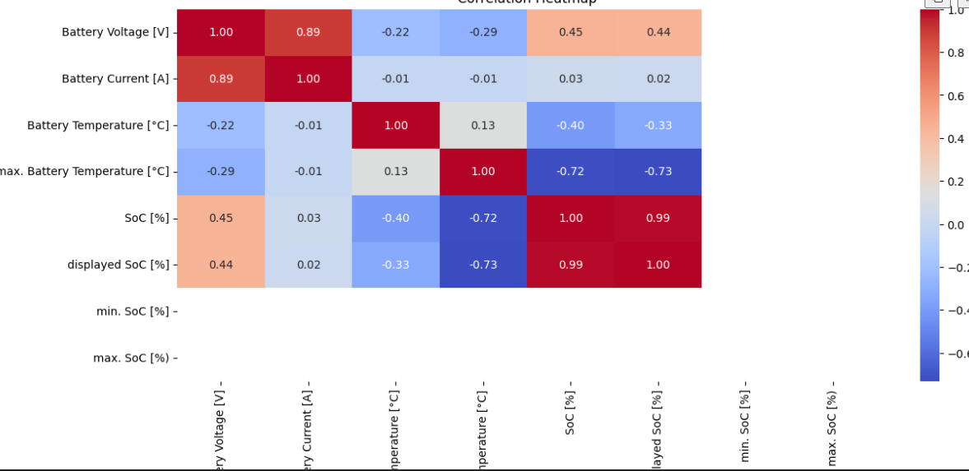
Correlation

Slide 36
Pre-processing
1. Data Inspection
Load the Data: Import the datasets and inspect the first few rows to understand the structure and contents.
Check for Missing Values: Identify any missing or null values in the datasets.
Examine Data Types: Verify the data types of each column to ensure they are appropriate for analysis.
2. Data Cleaning
Handle Missing Values:
Imputation: Fill missing values with appropriate imputation methods, such as mean, median, or mode, depending on the column's nature.
Removal: If missing values are sparse and not critical, rows or columns with excessive missing data might be removed.
Remove Duplicates: Check for and remove any duplicate rows to avoid redundancy.
Fix Data Types: Convert columns to the correct data types, e.g., converting date strings to datetime objects.

Slide 37
3. Data Transformation
Normalization/Scaling:
Feature Scaling: Normalize or standardize numerical features to ensure that all features contribute equally to the model. Techniques such as Min-Max scaling or Standardization (Z-score normalization) may be used.
Encoding Categorical Variables: Convert categorical variables into numerical format using techniques like one-hot encoding or label encoding, if applicable.
Feature Engineering: Create new features or modify existing ones to enhance model performance. For example, derive features such as battery temperature from timestamps or usage patterns.

Slide 38
4. Data Integration
Combine Datasets (if applicable): If using multiple datasets, merge them on relevant keys or indices. Ensure that the data integration process aligns with the analysis goals and preserves the integrity of the data.
Synchronize Time Series Data: For time-dependent data, ensure that timestamps are aligned if combining multiple sources.
5. Exploratory Data Analysis (EDA)
Statistical Summary: Generate statistical summaries (mean, median, standard deviation) of numerical features to understand their distributions.
Visualizations: Create visualizations such as histograms, box plots, and scatter plots to explore data distributions and relationships between variables.
Correlation Analysis: Check for correlations between features to identify important variables and potential multicollinearity issues.

Slide 39
6. Data Splitting
Train-Test Split: Divide the data into training and testing sets. A typical split might be 80% for training and 20% for testing, but this can be adjusted based on the dataset size and requirements.
Cross-Validation: Consider setting up cross-validation to evaluate model performance more reliably, especially if the dataset is large and diverse.
7. Handling Imbalanced Data (if applicable)
Check for Class Imbalance: In classification tasks, check if the classes are balanced. If not, apply techniques like resampling (oversampling the minority class or undersampling the majority class) or use weighted loss functions to address imbalances.
8. Feature Selection
Select Important Features: Identify and select the most relevant features for the modeling process. Techniques such as Recursive Feature Elimination (RFE), feature importance from tree-based models, or correlation analysis can be used.

Slide 40
Algorithm Definition
Deep Neural Networks (DNN):
Deep Neural Networks (DNN) are layered architectures where each layer transforms the input data into more abstract representations, enabling the model to learn complex patterns. In the context of predicting battery states in electric vehicles, a DNN is employed to capture intricate relationships between various features such as voltage, temperature, and current. The DNN's multi-layer structure, consisting of input, hidden, and output layers, allows it to model non-linear interactions among features. The network is trained using backpropagation, which minimizes the difference between the predicted and actual battery states. DNNs are particularly effective in this project for handling large-scale datasets, capturing high-dimensional correlations, and improving the accuracy of state predictions like state of charge (SOC) and state of health (SOH). However, DNNs can be prone to overfitting, making explainability challenging, which is why they are combined with other algorithms to enhance robustness and interpretability.

Slide 41
Long Short-Term Memory (LSTM) Networks:
Long Short-Term Memory (LSTM) networks are a type of recurrent neural network (RNN) designed to capture temporal dependencies in sequential data. In this project, LSTMs are utilized to model the time-series nature of battery data, such as charging and discharging cycles. The LSTM architecture includes memory cells that retain information over long periods, which is crucial for understanding how past battery states influence future states. By incorporating forget gates and input-output mechanisms, LSTMs can selectively remember or discard information, making them ideal for capturing complex temporal patterns in battery behavior. LSTMs help predict SOC and SOH by learning from historical data trends, allowing the digital twin model to anticipate future battery performance under varying conditions. Their ability to model sequential data with long-term dependencies enhances the accuracy and reliability of the predictions.
.

Slide 42
Convolutional Neural Networks (CNN):
Convolutional Neural Networks (CNN) are typically used for image processing but have been adapted in this project to extract spatial patterns from sensor data representing battery states. In the context of EV batteries, CNNs are applied to time-series data formatted as matrices, where the convolutional layers scan through the data to detect local patterns, such as voltage spikes or temperature variations. These patterns are then aggregated through pooling layers, which reduce the dimensionality while preserving essential features. By stacking multiple convolutional layers, the CNN can learn hierarchical representations of battery data, enabling it to detect complex interactions between different features. This capability is particularly useful for identifying abnormal battery behavior and predicting states like SOC and SOH. CNNs contribute to the digital twin model by providing high-level feature extraction that complements the temporal modeling capabilities of LSTMs.

Slide 43
Support Vector Regression (SVR):
Support Vector Machines (SVM) are primarily used for classification tasks but can also be adapted for regression. In this project, SVM is employed to classify battery states under different operational conditions. The algorithm works by finding the optimal hyperplane that separates different classes of data in a high-dimensional space. The SVM maximizes the margin between classes, which enhances the model's robustness to noise and outliers. In the context of battery state prediction, SVM is used to distinguish between healthy and degraded battery states, contributing to the overall digital twin model by providing clear decision boundaries. The kernel trick allows SVM to handle non-linear relationships, making it suitable for complex battery data where linear separability is not possible.

Slide 44
Feedforward Neural Networks (FNN):
Feedforward Neural Networks (FNN) are the simplest form of neural networks where connections between the nodes do not form a cycle. In this project, FNNs are used as a baseline model for predicting battery states. The network consists of an input layer, one or more hidden layers, and an output layer. Each neuron in the hidden layers applies a weighted sum followed by an activation function to the inputs, enabling the network to learn non-linear relationships between the features. The FNN is trained using backpropagation to minimize the error between predicted and actual battery states. Although FNNs are less complex compared to DNNs and LSTMs, they are still effective in modeling simple patterns in the data. FNNs serve as a starting point for more advanced models in the digital twin framework, offering a balance between simplicity and predictive performance.

Slide 45
Radial Basis Function (RBF) Networks:
Radial Basis Function (RBF) networks are a type of artificial neural network that uses radial basis functions as activation functions. In this project, RBF networks are employed to capture localized patterns in the battery data. The network structure consists of an input layer, a hidden layer where each neuron applies an RBF to the input, and an output layer that provides the prediction. RBF networks are particularly effective in scenarios where the relationship between inputs and outputs is non-linear and localized. By adjusting the width of the radial basis functions, the network can focus on specific regions of the input space, making it suitable for detecting anomalies or specific states in battery behavior. RBF networks contribute to the digital twin by providing localized predictions that can complement the global patterns captured by other algorithms.

Slide 46
Random Forests (RF):
Random Forests (RF) is an ensemble learning method that builds multiple decision trees and merges them to get a more accurate and stable prediction. In this project, RF is used to predict battery states by combining the outputs of several decision trees trained on different subsets of the data. Each tree in the forest makes a prediction, and the final output is determined by averaging the predictions (in the case of regression) or by majority voting (in the case of classification). RF is particularly robust to overfitting due to its use of bootstrapped datasets and random feature selection for each tree. This method enhances the predictive accuracy and reliability of the digital twin by capturing a diverse set of patterns in the battery data.

Slide 47
Extreme Gradient Boosting (XGBoost):
Extreme Gradient Boosting (XGBoost) is a powerful and efficient implementation of gradient boosting, which is used to optimize prediction performance by sequentially building trees that correct the errors of previous ones. In this project, XGBoost is employed to refine battery state predictions by minimizing prediction errors iteratively. XGBoost applies regularization techniques to prevent overfitting and handles missing data effectively, making it ideal for complex datasets. The algorithm's ability to model interactions between features and capture non-linear patterns significantly improves the accuracy of SOC and SOH predictions. XGBoost's efficiency and scalability make it a crucial component of the digital twin model, providing fast and accurate predictions even with large-scale data.

Slide 48
Comparision of Regression Models
Deep Neural Networks (DNN) | 0.9993198362925221
Long Short-Term Memory (LSTM) Networks | 0.9998667004762997
Convolutional Neural Networks (CNN) | 0.8349752763093162
Support Vector Regression (SVR) | 0.08241820187851746
Feedforward Neural Networks (FNN) | 0.3341144833732904
Radial Basis Function (RBF) Networks | 0.9959972716919308
Random Forests (RF) | 0.9973440376045685
Extreme Gradient Boosting (XGBoost) | 0.9973675219909928

Slide 49
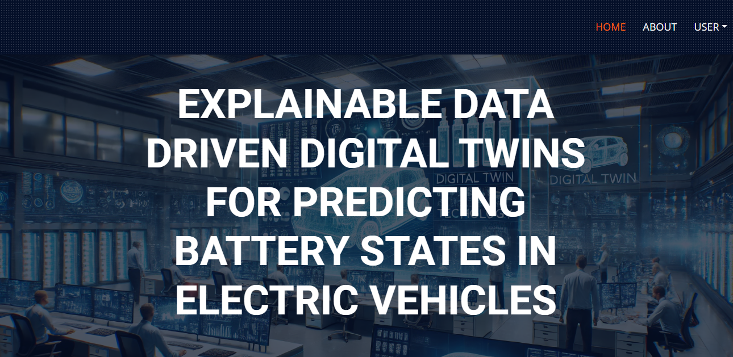
HomePage: The HomePage serves as the landing page of your application. It provides an overview of the project's features, objectives, and benefits. Users can navigate to other sections of the application from this page.

Slide 50
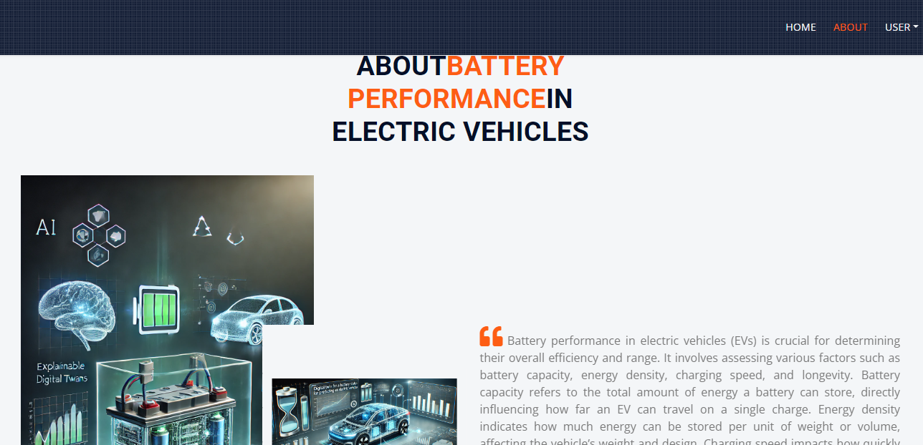
AboutPage: The AboutPage offers detailed information about the project, including its purpose, goals, and the technology used. It provides background information on the problem being addressed and the methods employed.

Slide 51

Registration Page: The Registration Page allows new users to create an account with the application. It typically includes fields for entering personal information such as name, email, password, and possibly other details like phone number or address. Users need to fill out this form to gain access to the application's features.

Slide 52

Login Page : The Login Page enables users to access their existing accounts by entering their credentials. It usually includes fields for entering a username/email and password.

Slide 53
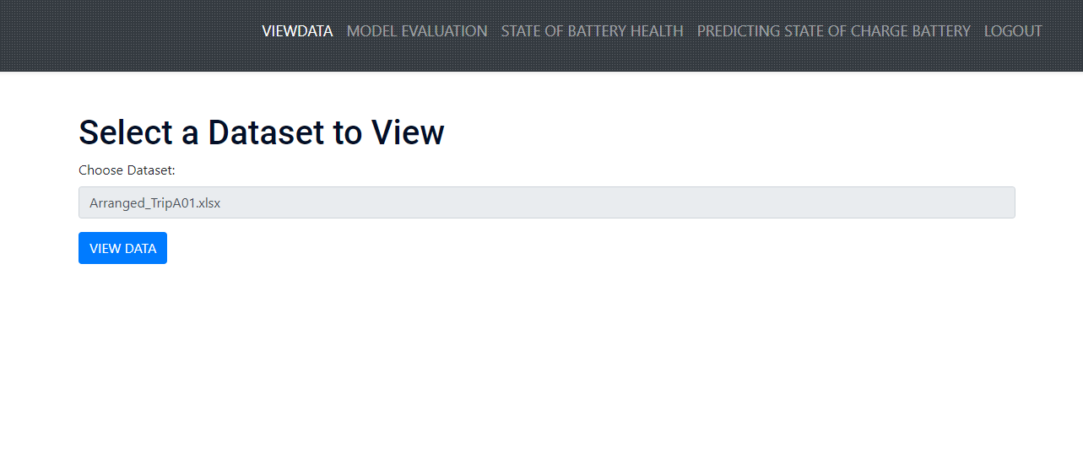
View data page:In this page user can view the dataset data in the table format

Slide 54
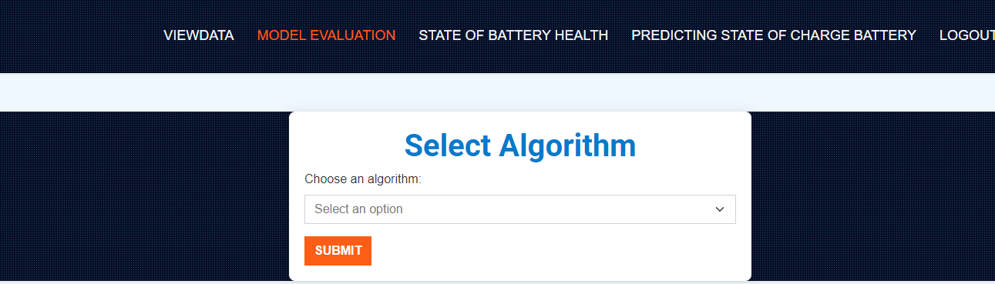
Model:In this page user can select the particular algorithm so that the particular algorithm produce the respective r2_score

Slide 55
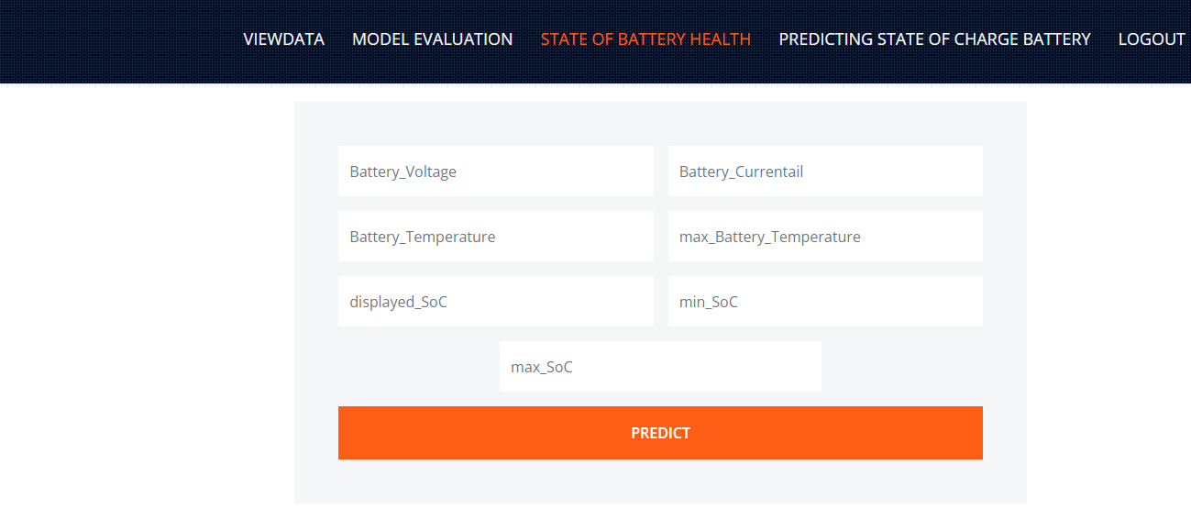
Prediction Page: : The Prediction Page allows users to input data and receive predictions based on the trained machine learning models. This page typically includes a form or interface for uploading or entering data (e.g., smartwatch sensor data).

Slide 56
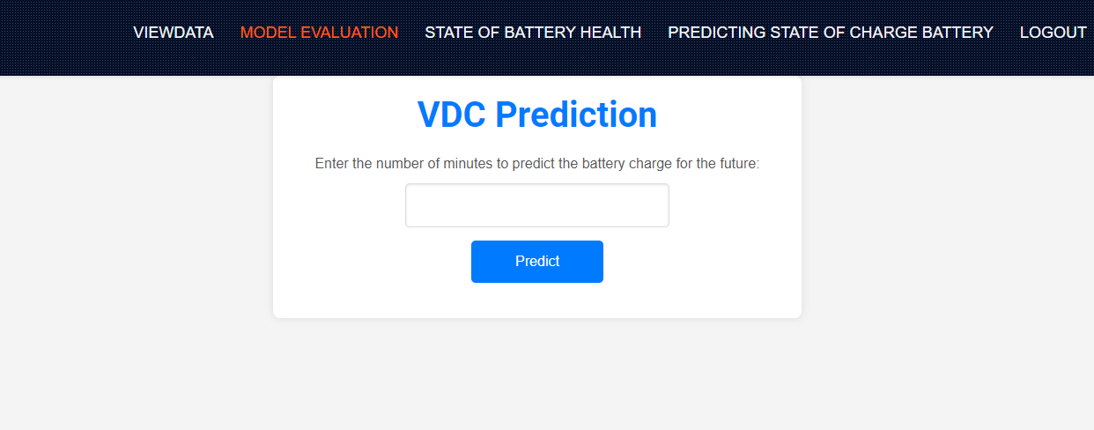

Slide 57
CONCLUSION:
This research introduces a pioneering approach using Explainable Data-Driven Digital Twins for predicting battery states in electric vehicles (EVs), leveraging a diverse array of advanced machine learning algorithms. By integrating models such as Deep Neural Networks (DNN), Long Short-Term Memory (LSTM) networks, Convolutional Neural Networks (CNN), Support Vector Regression (SVR), Support Vector Machines (SVM), Feedforward Neural Networks (FNN), Radial Basis Function networks (RBF), Random Forests (RF), and Extreme Gradient Boosting (XGBoost), we have developed a comprehensive digital twin model that enhances the accuracy and reliability of battery state predictions.The primary objectives of this study—improving the predictability of key battery parameters like state of charge (SOC) and state of health (SOH)—have been successfully met.

Slide 58
FUTURE ENHANCEMENT
1. Incorporation of Additional Data Sources
Extended Data Collection: Integrate more diverse data sources such as real-time sensor data, vehicle operating conditions, and environmental factors. This could improve the model’s ability to handle various scenarios and provide more accurate predictions.
Data Fusion: Combine data from different sensors and sources to create a more holistic view of battery performance, enhancing the model’s predictive power.
2. Advanced Machine Learning Techniques
Hybrid Models: Explore the use of hybrid models that combine the strengths of different machine learning techniques, such as ensemble methods that integrate predictions from multiple algorithms.
Transfer Learning: Apply transfer learning to leverage pre-trained models and adapt them to specific battery types or new operational environments, reducing the need for extensive retraining.

Slide 59
REFERENCES
1. Zhou, K., Yang, S., & Shen, C. (2016). "A review on the development and application of digital twins in the automotive industry." IEEE Access, 4, 1848-1858. doi:10.1109/ACCESS.2016.2566403.
2. Jia, L., & Zhang, Y. (2018). "A survey of machine learning for big data processing in battery management systems." IEEE Transactions on Industrial Informatics, 14(4), 1635-1645. doi:10.1109/TII.2017.2785224.
3. Wang, X., & Zhang, J. (2020). "State-of-charge and state-of-health estimation for lithium-ion batteries based on a hybrid machine learning model." Journal of Energy Storage, 30, 101514. doi:10.1016/j.est.2020.101514.
4. Lee, J., & Kwon, Y. (2019). "Data-driven digital twins for smart manufacturing: A review and future directions." IEEE Transactions on Industrial Informatics, 15(12), 6658-6668. doi:10.1109/TII.2019.2916845.
5. Liu, H., & Zhao, Y. (2021). "Explainable artificial intelligence for healthcare: A review of recent advances." Journal of Healthcare Engineering, 2021, 8887364. doi:10.1155/2021/8887364.
6. Wang, S., & Wang, Y. (2021). "Deep learning and its applications in battery management systems." Energy Reports, 7, 117-126. doi:10.1016/j.egyr.2021.02.005.

Slide 60
7. Yuan, Y., & Xu, J. (2020). "Long Short-Term Memory neural network based battery state of charge estimation for electric vehicles." Energies, 13(2), 424. doi:10.3390/en13020424.
8. Kumar, S., & Weng, X. (2020). "Radial Basis Function Neural Networks for battery state prediction in electric vehicles." Energy Conversion and Management, 207, 112582. doi:10.1016/j.enconman.2020.112582.
9.Chen, J., & Zhou, X. (2022). "Explainable AI methods for battery health management: A review." IEEE Transactions on Intelligent Transportation Systems, 23(7), 10485-10498. doi:10.1109/TITS.2022.3154382.
10. Sharma, S., & Singh, A. (2020). "Predictive modeling and machine learning techniques for battery state estimation: A review." Energy, 191, 116614. doi:10.1016/j.energy.2019.116614.
11. Kang, J., & Gao, D. (2018). "Convolutional Neural Networks for battery state-of-health estimation in electric vehicles." Applied Energy, 231, 1054-1064. doi:10.1016/j.apenergy.2018.09.086.
12. Huang, C., & Liu, L. (2021). "Support Vector Machines for state-of-charge estimation in lithium-ion batteries." Journal of Power Sources, 494, 229743. doi:10.1016/j.jpowsour.2021.229743.
13. Yang, Z., & Zhang, Y. (2021). "Integration of machine learning techniques for battery health prediction and management." Energy Reports, 7, 207-217. doi:10.1016/j.egyr.2021.01.043.

Slide 61
THANK YOU

